Slide 1
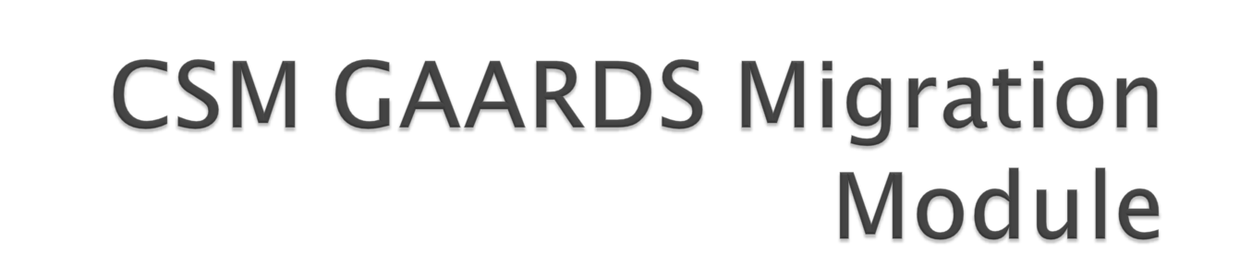
Vijay Parmar

Slide 2
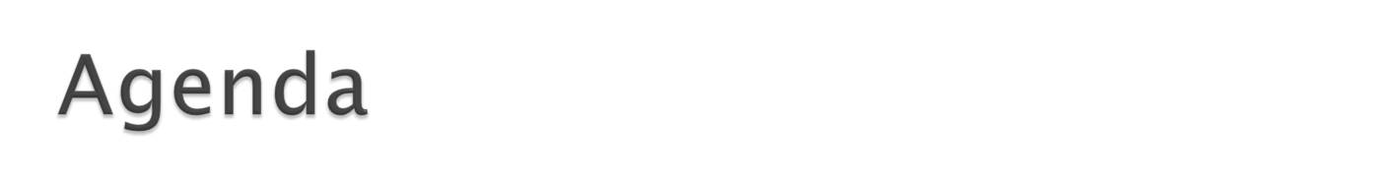
Introduction
Requirements addressed
  Business, Policy,Technical.
CGMM Components and Overall Architecture
CGMM Workflows
CGMM User Interface
Technical Environment, Assumptions, known Issues
Documentation. Questions?

Slide 3

Common Security Module (CSM)
Grid Authentication and Authorization with Reliably Distributed Services (GAARDS)
CSM GAARDS Migration Module is a web application tool which allows automated and user-oriented process of migrating CSM user ID to GAARDS user ID and allow an application to use GAARDS based authentication.
Notes:
Common Security Module (CSM) provides Application security tools that address authentication, authorization and user provisioning.
Grid Authentication and Authorization with Reliably Distributed Services (GAARDS) provides services and tools for administration and enforcement of security policy in an enterprise Grid.
CSM GAARDS Migration Module is a web application tool which allows automated and user-oriented process of migrating CSM user’s to GAARDS user’s and allow an application to use GAARDS based authentication.

Slide 4


Single Set of Credentials
GAARDS based authentication
Migrate local account usage to caGrid account use.
Provisioning of new users with Grid Identities.
To use caBIG approved Identity Providers and thus allowing federation of identity
Notes:
Single Set of Credentials
The existing web applications having CSM based authentication is required to provide Grid based authentication. Hence users with CSM credentials as well as Grid credentials can access all components of existing web application.
The requirement is to avoid duplication of accounts for existing and new users. The application needs to provide a single set of credentials to access various above mentioned components.
GAARDS based authentication
The requirement is to switch CSM based authentication to caGrid’s GAARDS based authentication. Users should not be allowed to login using CSM credentials once they are migrated.
Migrate Accounts
The Migration module will enable migrating of existing users accounts from CSM accounts to Grid accounts. This will make users authenticated against GAARDS for scalability and federation.
Provisioning of new users with Grid Identities.
New users should be allowed to create Grid accounts and login to existing application using Grid credentials. The existing applications Authorization policy provisioning should be enhanced to allow users Grid Identities instead of CSM credentials.
To use caBIG approved Identity Providers and thus allowing federation of identity
The web application should use a caBIG approved Identity Provider as your credential source. This way any user which is member of those Identity Providers can log onto the application (provided the user has appropriate access permission if any).

Slide 5

Seamless integration of Migration Module with existing web application
Configurable Look and Feel
Configurable caGrid Identity Providers for authentication
Migration Module to support caGrid 1.2
Notes:
Seamless integration of Migration Module with existing web application
The Migration Module should be integrated with minor modifications to the Host application
Configurable Look and Feel
The Migration Module web application should be configurable to allow the Host web application to plug in their look and feel. The Migration module web application should support the look and feel available in current NCICBIIT web application Templates.
Configurable CaGrid Identity Providers for Authentication
The Migration Module web application should allow authentication of Users against a configurable list of Identity Providers (Authentication Services) and their corresponding Dorian URL’s. The configuration shall be made via an external properties file for the Migration Module application.
Migration Module supports cagrid 1.2
caGrid 1.2 is supported and the migration module will use Authentication and Dorian Services created using caGrid 1.2.

Slide 6
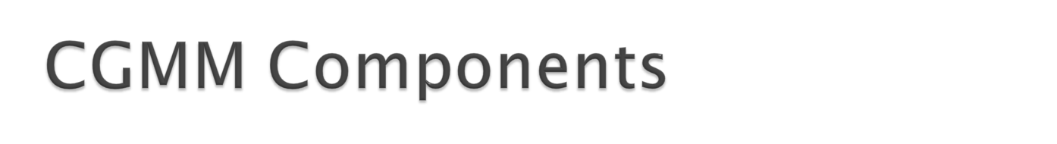
Host Application
  CGMM Filter
CGMM
  CGMM Web Application
  CGMM API
caGrid 1.2 services
  Authetication Service
  Dorian
  SyncGTS
Notes:
The following are the minimum set of components involved in the Migration Module Framework. The following section describes the design for CSM GAARDS Migration Module and integration with Host applications.
CGMM Filter
A new HTTP filter (provided as part of the CGMM) is configured to intercept and forward the user requests to the CGMM to either migrate the user account or to login the user into the Host application. Depending on whether the user is an existing application user or not, the control is passed back either to the login workflow or the new user creation workflow respectively.
CSM – GAARDS Migration Module web application (CGMM)
To assist in the migration of local CSM accounts to caGrid, CGMM is provided. CGMM is a separate web application that resides in the same container as the Host web application. CGMM also provides the Servlet Filter that is placed in front of the Host application intercepting and routing each user request for login or migration purpose. Detailed work flow of the migration module and the considered scenarios are provided in the next section.
Authentication Service
The IdPs registered on NCICB Production Grid will be used as the Identity Provider to validate user’s credentials. They will authenticate the user and provide a SAML token
Dorian
The NCICB Production Dorian is used as a Federation Service to generate user’s grid identity. This Dorian instance will also host all the users migrated from individual local host application instances which are not associated to any other IdPs.
SyncGTS
Sync GTS will be installed in CGMM for the Host application. Sync GTS daemon will keep the Host application in sync with the Grid Trust Fabric and update the CRL’s accordingly. Once the CGMM obtains Grid proxy from Dorian it will validate the proxy against the GTS to make sure the certificate is still valid and has not been revoked.

Slide 7

Host Application
Requested Flow
New User Flow
User Info + Grid Proxy
User Request
CGMM Filter
Pass control
User Info + Grid Proxy
Client
Perform Login
Pass control
CSM LOGIN
GRID LOGIN
CGMM Manager
CSM Login Screen
CSM 4.1 Schema
Validate CSM Credentials
Authentication or Migrate
Grid Login Screen
Authentication Grid User
Authentication Service
Validate Grid Credentials
Create New Dorian User account
Dorian
New Grid User
Screen
Create New Grid User
CGMM Web Tool
Validate Proxy
Web Server
SyncGTS

Slide 8
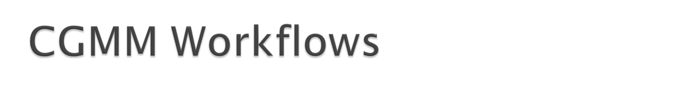
The CGMM Tool allows multiple scenarios/workflows based on the User. The user may or may not have CSM account. The user also may or may not have a caGrid Account.
Based on the above there are four different scenarios addressed by the CGMM Tool. The scenarios are as following:
  User logs in with CSM account and User does not have a caGrid account.
  User logs in with CSM account and User has a caGrid account
  User logs in with caGrid account and User does not have a CSM account
  User logs in with caGrid account and User has a CSM account.
Note: The CGMM tool DOES NOT address the scenario where a User does not have a CSM (local) Account and does not have a caGrid account as well. The host application needs to address this scenario.

Slide 9

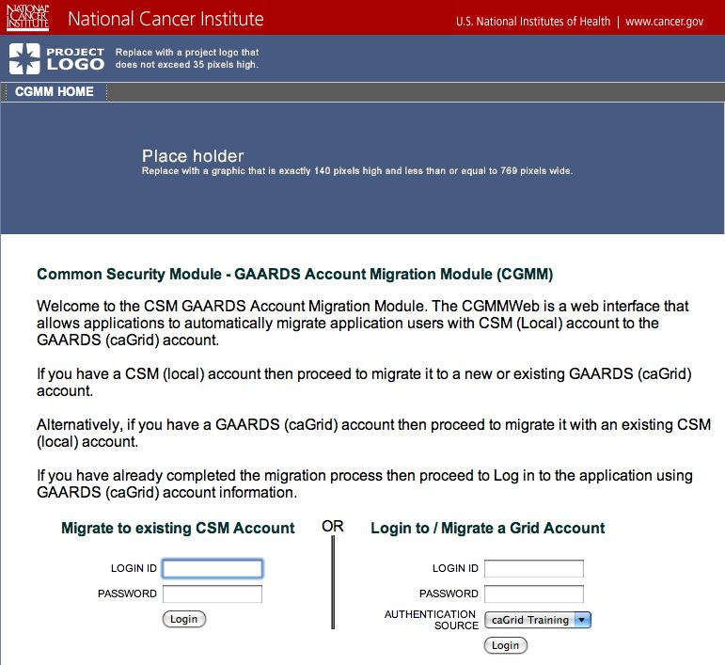

Slide 10
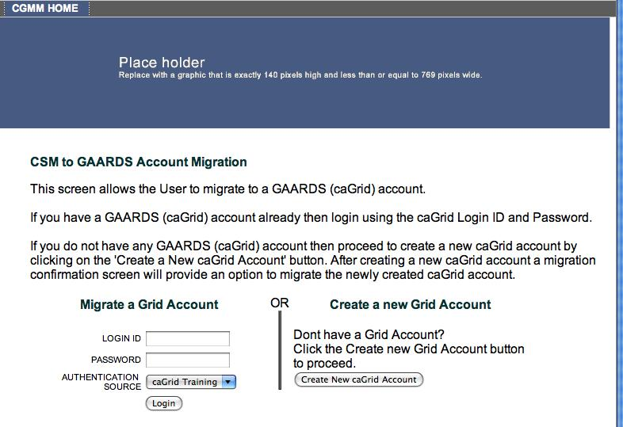
User is already authenticated with valid CSM login ID and password.

Slide 11
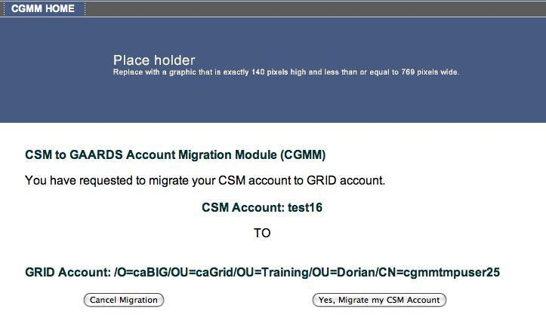
- User is already authenticated with valid CSM login ID and password.
User is also authenticated with valid GAARDS (caGrid) based Login ID,
Password against Authentication Source (service).
Notes:
User provides valid GAARDS credentials for migration

Slide 12
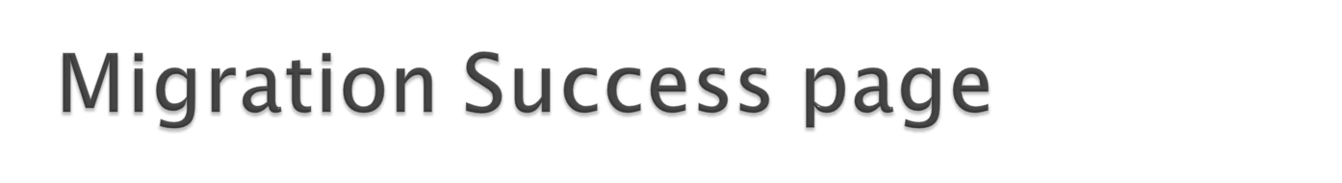
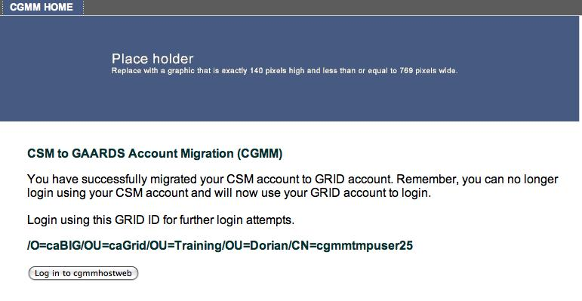

Slide 13

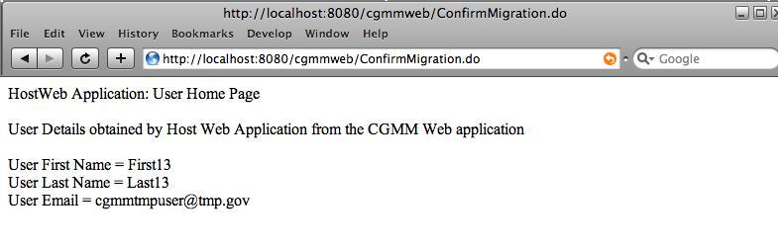

Slide 14

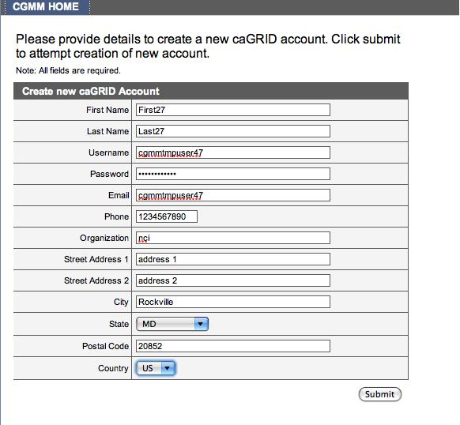

Slide 15

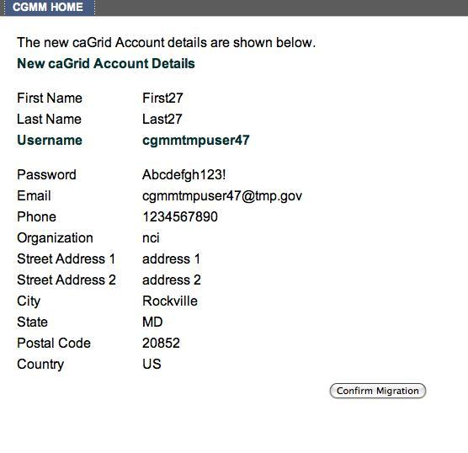

Slide 16

Client Interface
  Internet Explorer 6.0 and above
  Mozilla v1.5.0.3 and above (if possible)
Application Server
  Apache Tomcat 5.0.28
  JBoss 4.0.5
Operating system
  Windows XP
  Linux/Unix
Java 1.5
Globus Toolkit 4.0.3
caGrid Release v1.2

Slide 17
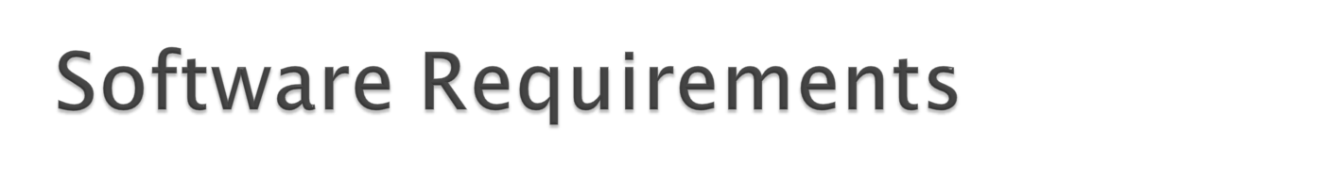
CaGrid 1.2 – Authentication Service, Dorian, SyncGTS.
  CGMM depends on the caGrid v1.2 for the client API’s of Authentication Service, Dorian and SynGTS
CSM v4.1 and CSM UPT v4.1
  The Host application will need to upgrade to CSM API v4.1 and CSM UPT v4.1 to leverage the new features implemented for the CGMM.

Slide 18
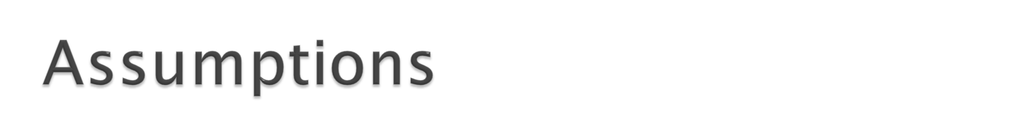
Migration Module and Migration Host application reside on same Application Server.
The Migration Host application has a New Local User Create Module/Implementation/Workflow.
Tomcat clustering is not done.
The Application Server hosting the web applications has the host CA credentials to establish communication with Authentication Service and Dorian Service.
The Maximum length of Grid ID is 500 characters.
The Grid proxy or Grid Identity shouldn’t be persisted when passing control between the Migration Module and Host web application.

Slide 19
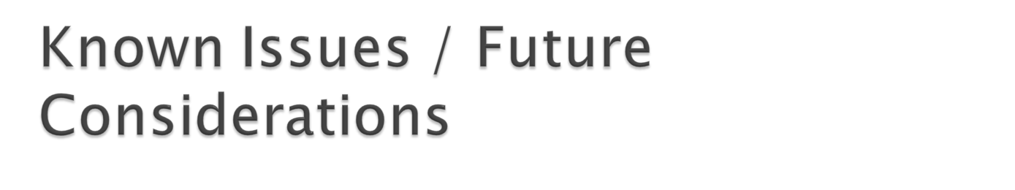
The Migration Module is designed with the assumption that the Host application has existing New CSM user creation and provisioning Workflow for authorization, to which the Migration Module will pass control over to as part of the New user CSM Create Use case.
The length of Grid Identity is not bounded in CaGrid. In CSM it is bounded to 500 characters.

Slide 20
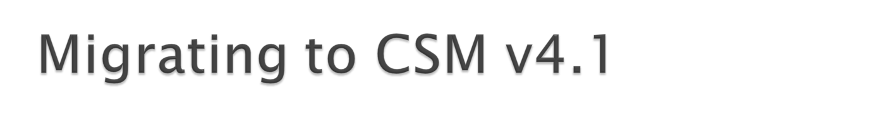
Migrate CSM v3.2 and CSM v4.0 Schemas to CSM v.4.1
Update CSM API to v4.1
Update CSM UPT to v4.1
Modify application(s) to use CGMM
  Co-host CGMM on same container
  Implement changes required to adapt to the CGMM workflow

Slide 21

CSM
  http://ncicb.nci.nih.gov/NCICB/infrastructure/cacore_overview/csm
GAARDS
  http://www.cagrid.org/wiki/GAARDS:Main
CSM GAARDS Migration Module Guide
  http://gforge.nci.nih.gov/docman/view.php/12/15148/CSM41_GAARDSMigrationModuleGuide.pdf

Slide 22
